Slide 1

Session Name:
Decision-Making Under Uncertainty & Risk
Delivered By:
Vikash Singh

Slide 2
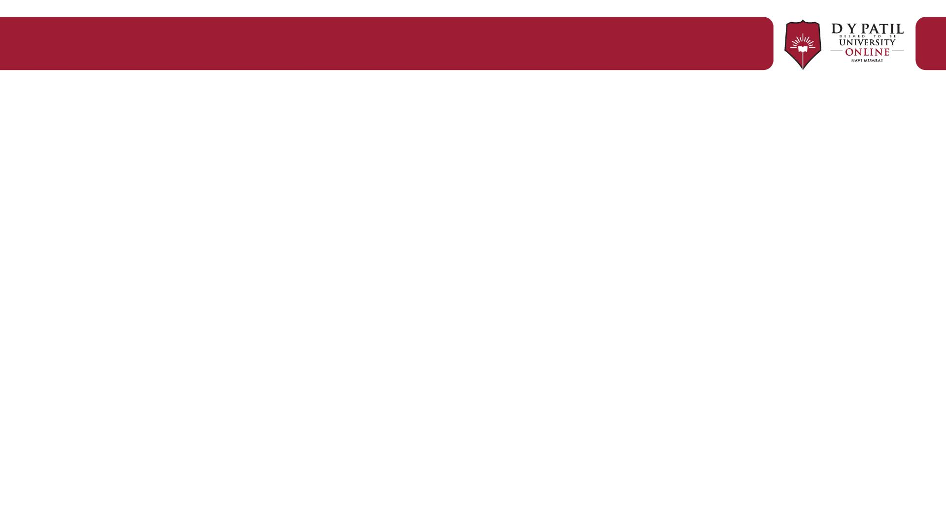
Learning Objectives
By the end of this session, you will be able to:
Understand decision types (certainty, risk, uncertainty)
Apply decision rules and expected values
Understand DSS vs MIS

Slide 3
What is Decision-Making?
Decision-making is the process of choosing the best alternative among several options.
Especially important when information is incomplete or outcomes are uncertain.

Slide 4
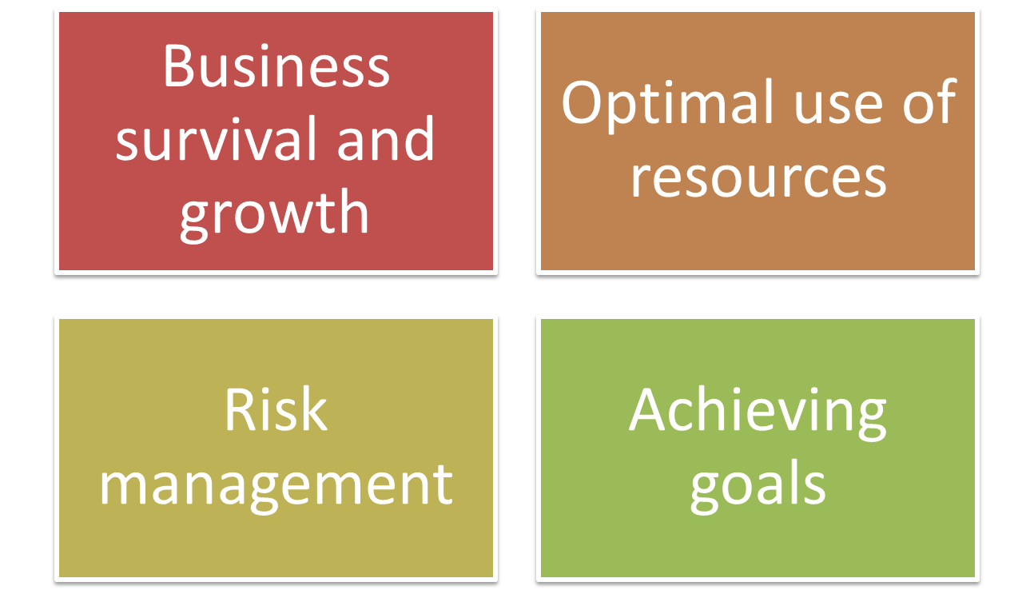
Importance of Decision-Making

Slide 5
Types of Managerial Decision-Making
Certainty: Outcomes known
Risk: Probabilistic outcomes
Uncertainty: No probabilities known

Slide 6
Decision-Making Under Certainty
- Clear, predictable outcomes
Example: Vendor guarantees 100% delivery

Slide 7
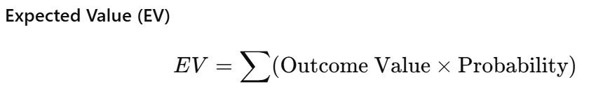
Decision-Making Under Risk
Several possible outcomes, each with known probabilities.
Data – for a given proposed plan, we have he following possibilities:
Profit if successful = ₹5000 (70% probability)
Loss if failed = ₹2000 (30% probability)
Should the manager take this decision?

Slide 8
Decision-Making Under Risk
Data – for a given proposed plan, we have he following possibilities:
Profit if successful = ₹5000 (70% probability)
Loss if failed = ₹2000 (30% probability)
Should the manager take this decision?

Slide 9
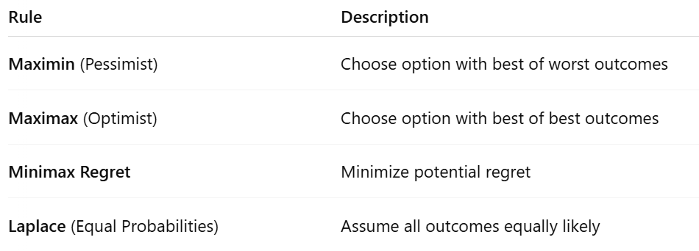

Decision-Making Under Uncertainty
Outcomes are unknown; no probabilities assigned.

Slide 10





Maximin and Maximax
Option | Worst Payoff | Best Payoff
A | 1000 | 5000
B | 1500 | 4000
✅ Maximin → Choose Option ?
✅ Maximax → Choose Option ?

Slide 11


Maximin and Maximax
Option | Worst Payoff | Best Payoff
A | 1000 | 5000
B | 1500 | 4000
✅ Maximin → Choose Option B (1500 > 1000) . Best amongst the worst.
✅ Maximax → Choose Option A (5000 > 4000). Best amongst the best.

Slide 12
Minimax Regret Rule
Choose the option that minimizes the maximum regret.
State of Nature | A (₹) | B (₹) | C (₹)
Good Market | 8000 | 10000 | 7000
Bad Market | 4000 | 5000 | 3000
Step 1: Find Best Outcome in Each State:

Slide 13





Minimax Regret Rule
Choose the option that minimizes the maximum regret.
State of Nature | A (₹) | B (₹) | C (₹)
Good Market | 8000 | 10000 | 7000
Bad Market | 4000 | 5000 | 3000
Step 1: Find Best Outcome in Each State:
Good Market: ₹10000 (B)
Bad Market: ₹5000 (B)

Slide 14
Minimax Regret Rule
Step 2: Calculate and create Regret Table:
Regret = (Best payoff) - (Actual payoff)
State | A | B | C
Good | 2000 | 0 | 3000
Bad | 1000 | 0 | 2000

Slide 15
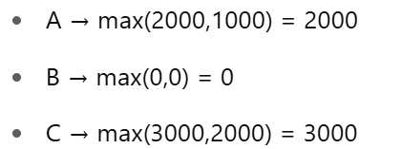
Minimax Regret Rule
Step 3: Find Max Regret for Each Option:
State | A | B | C
Good | 2000 | 0 | 3000
Bad | 1000 | 0 | 2000

Slide 16
Minimax Regret Rule
Solution: Find Max Regret for Each Option:
State | A | B | C
Good | 2000 | 0 | 3000
Bad | 1000 | 0 | 2000
Minimax Regret Decision = Choose Option B (lowest maximum regret = 0).

Slide 17









Laplace Rule (Equal Probability Approach)
Assume all outcomes equally likely
Choose option with highest average payoff.
Option | Good Market (₹) | Bad Market (₹)
A | 8000 | 4000
B | 10000 | 5000
C | 7000 | 3000

Slide 18
Laplace Rule (Equal Probability Approach)
Option | Good Market (₹) | Bad Market (₹)
A | 8000 | 4000
B | 10000 | 5000
C | 7000 | 3000
Calculate average for each option:
A: (8000 + 4000)/2 = ₹6000
B: (10000 + 5000)/2 = ₹7500
C: (7000 + 3000)/2 = ₹5000
Laplace Decision = Choose Option B (₹7500 is highest average payoff).

Slide 19
DSS vs. MIS
DSS (Decision Support Systems): Analytical, supports decision-making.
MIS (Management Information Systems): Routine reporting and operations.
Examples:
MIS - Daily sales report
DSS - Forecasting sales with different budgets

Slide 20
DSS vs. MIS
Feature | DSS | MIS
Purpose | Support complex decision-making | Provide routine operational reports
Flexibility | High | Structured
Example | Forecasting software | Sales report database

Slide 21
Systems Approach to Decision-Making
Organization = System of interrelated parts.
Decision-making = Considering impact on whole system.
Components:
- Inputs
- Processes
- Outputs
- Feedback
For example: Decision to cut marketing cost:
- Might increase short-term profit
- But may harm long-term customer growth
- Must evaluate total system impact!

Slide 22
MCQ
Q1: In which type of decision-making are outcomes certain? A) Risk B) Certainty C) Uncertainty D) None
Q2: Minimax Regret rule aims to: A) Maximize best outcome B) Minimize maximum regret C) Minimize costs D) Maximize profits
Q3: Which system is more analytical and flexible? A) MIS B) DSS

Slide 23
MCQ
Q1: In which type of decision-making are outcomes certain? A) Risk B) Certainty ✅ C) Uncertainty D) None
Q2: Minimax Regret rule aims to: A) Maximize best outcome B) Minimize maximum regret ✅ C) Minimize costs D) Maximize profits
Q3: Which system is more analytical and flexible? A) MIS B) DSS ✅

Slide 24
Session Summary
In this session, we have discussed about:
Understand decision types (certainty, risk, uncertainty)
Apply decision rules and expected values
Understand DSS vs MIS

Slide 25

Happy Learning

